Slide 1
Human Resources Department
CMSC 127

Slide 2
Discussion Outline
Database prototype 1 (60A% working)

Slide 3
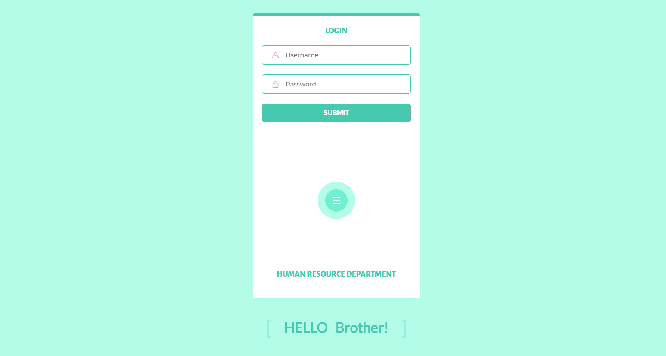
Home

Slide 4
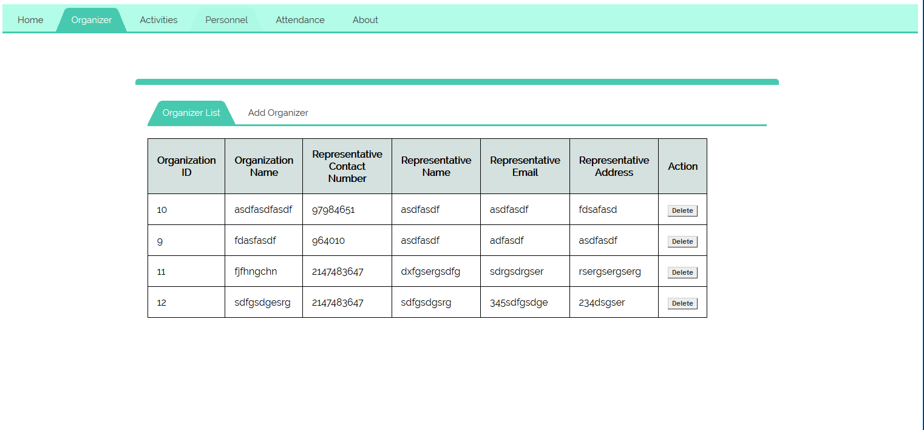
Organizer List

Slide 5
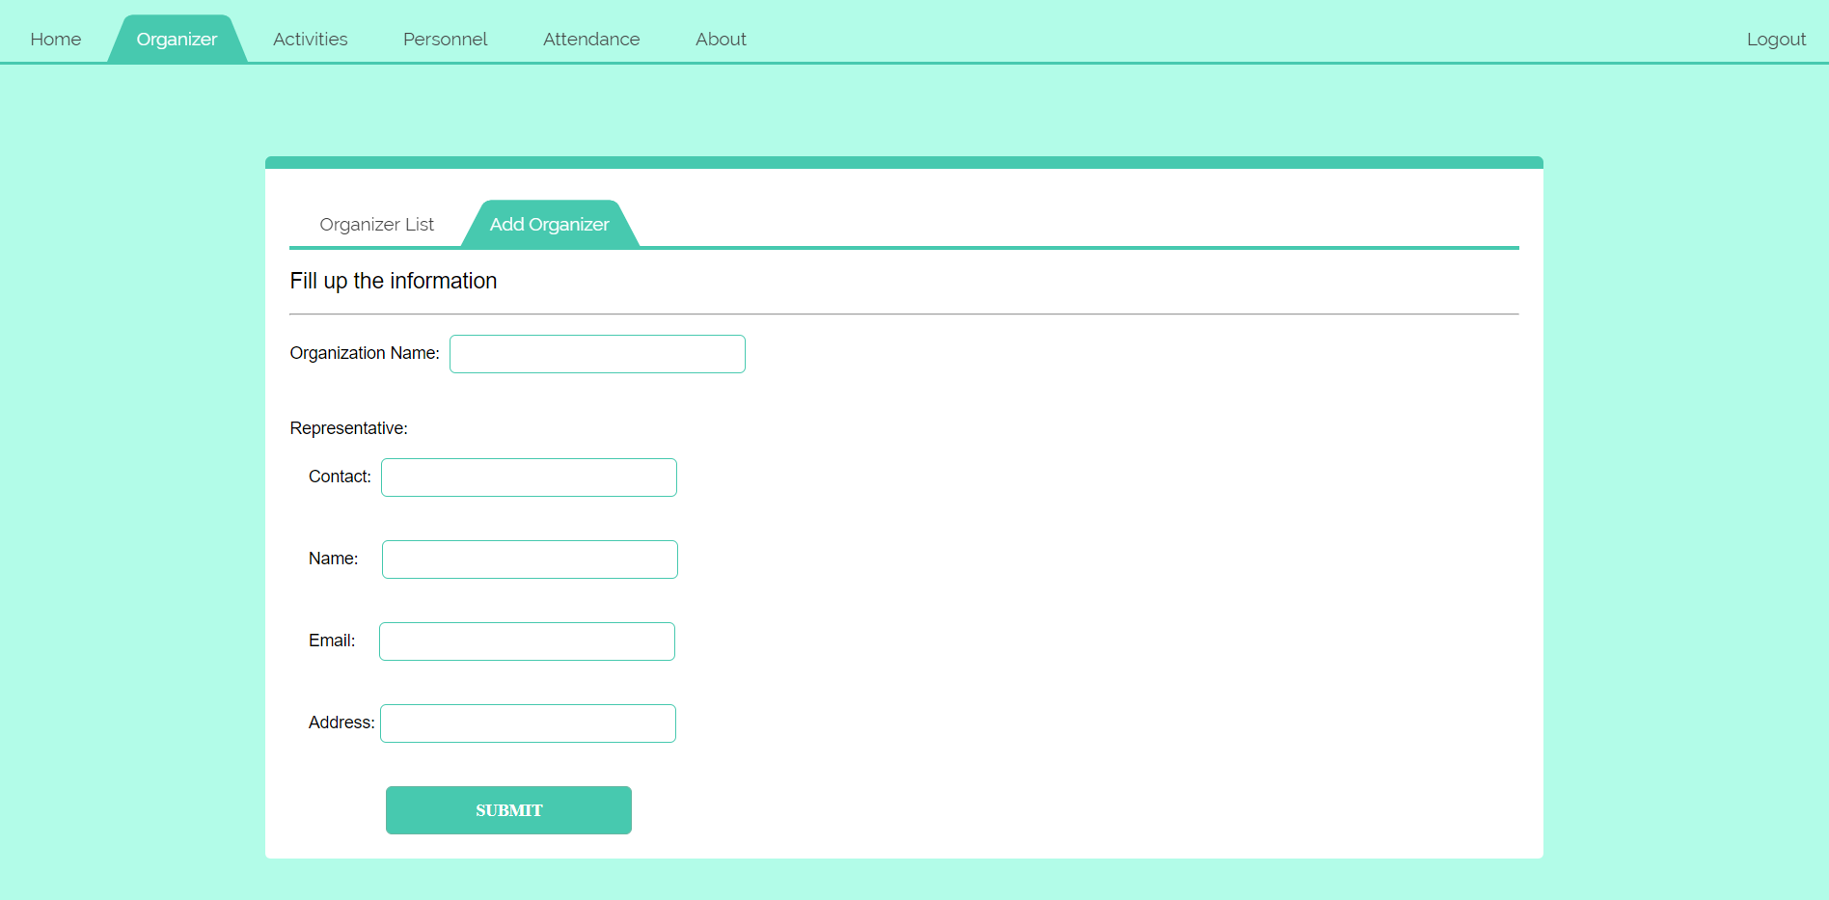
Add Organizer

Slide 6
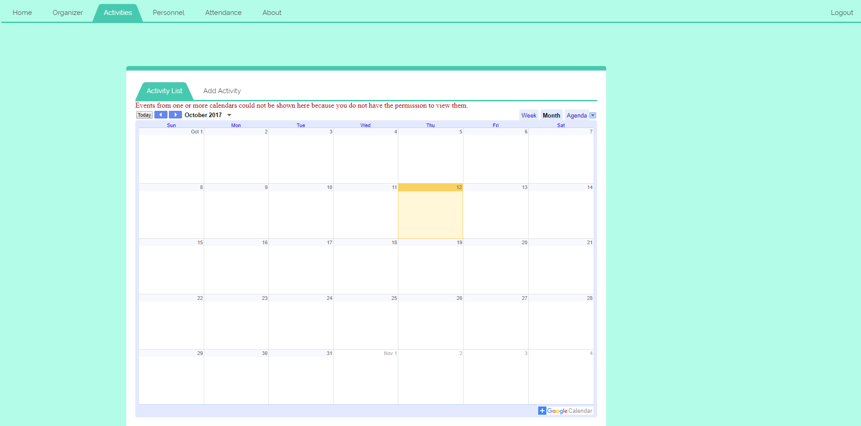
Activities

Slide 7
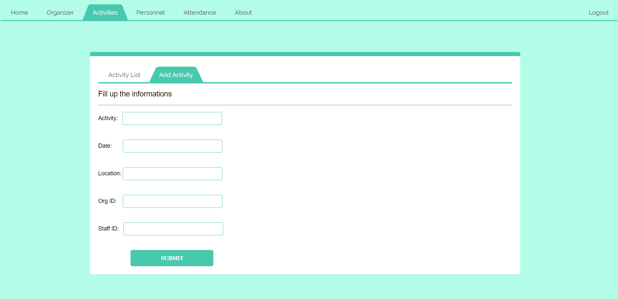
Add Activity

Slide 8
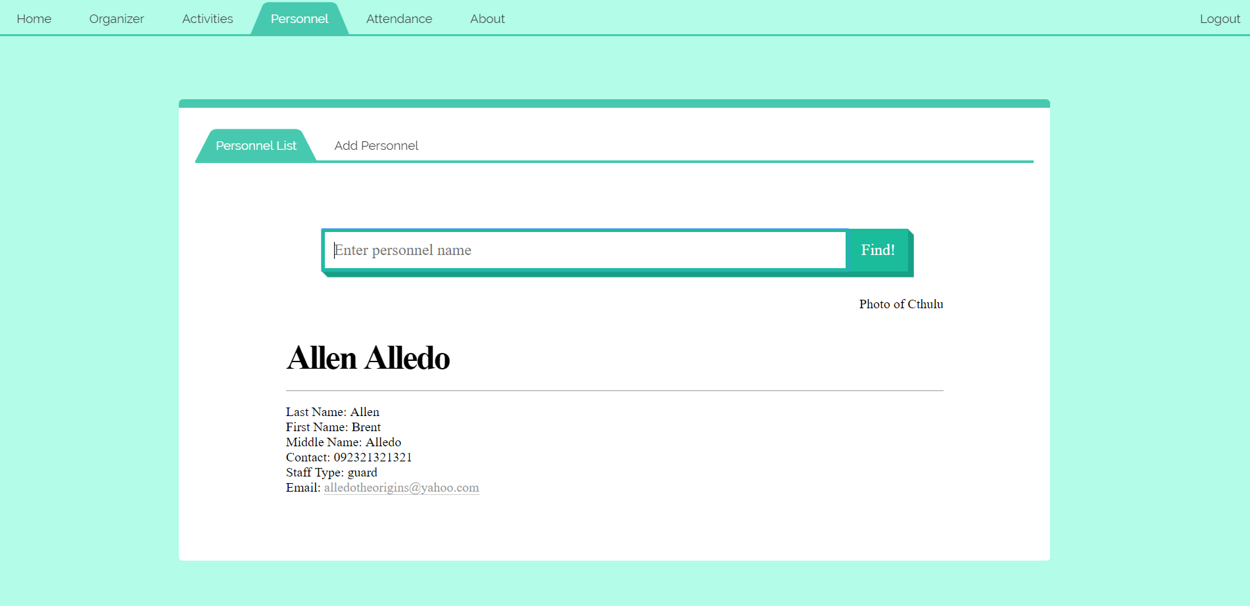
Personnel

Slide 9
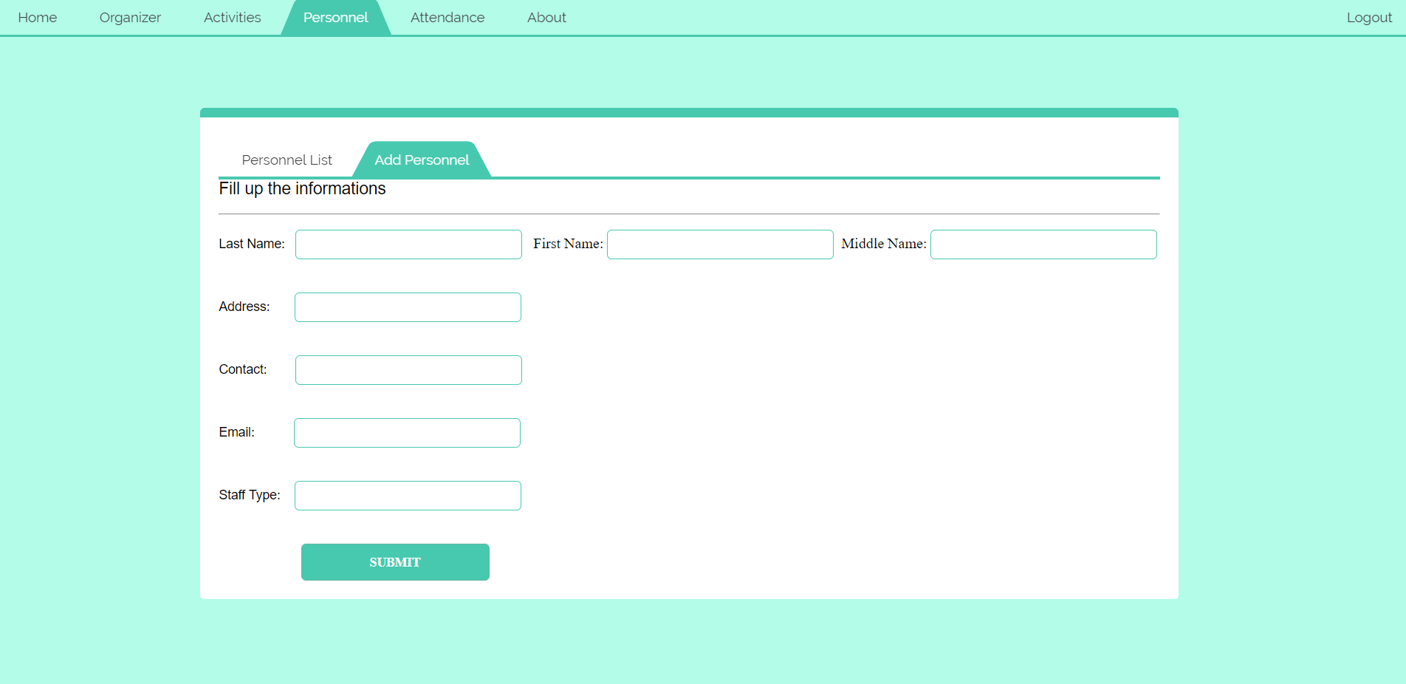
Add Personnel

Slide 10
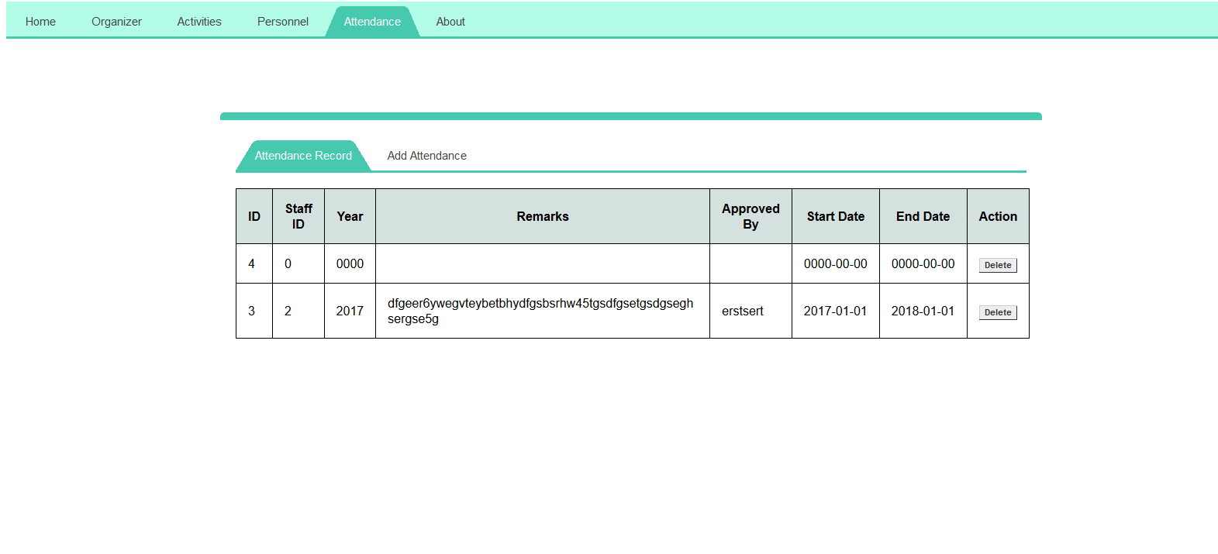
Attendance Record

Slide 11
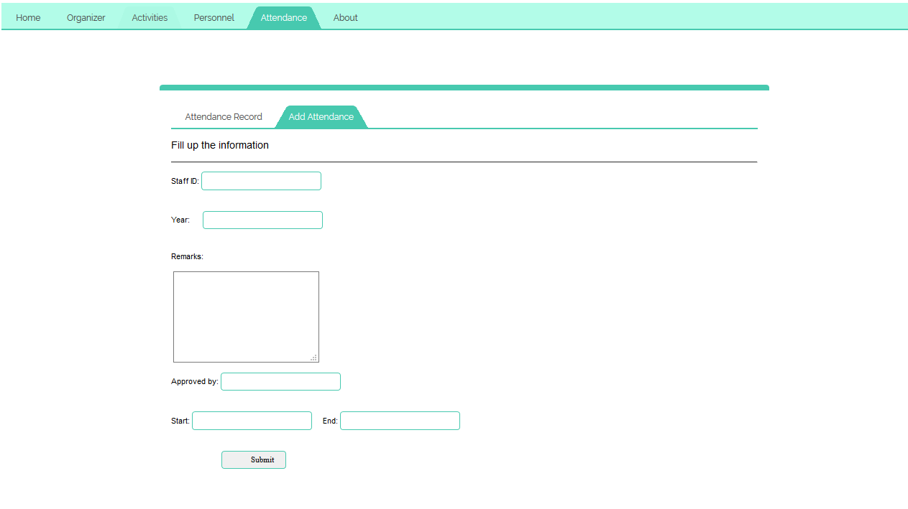
Add Attendance

Slide 12
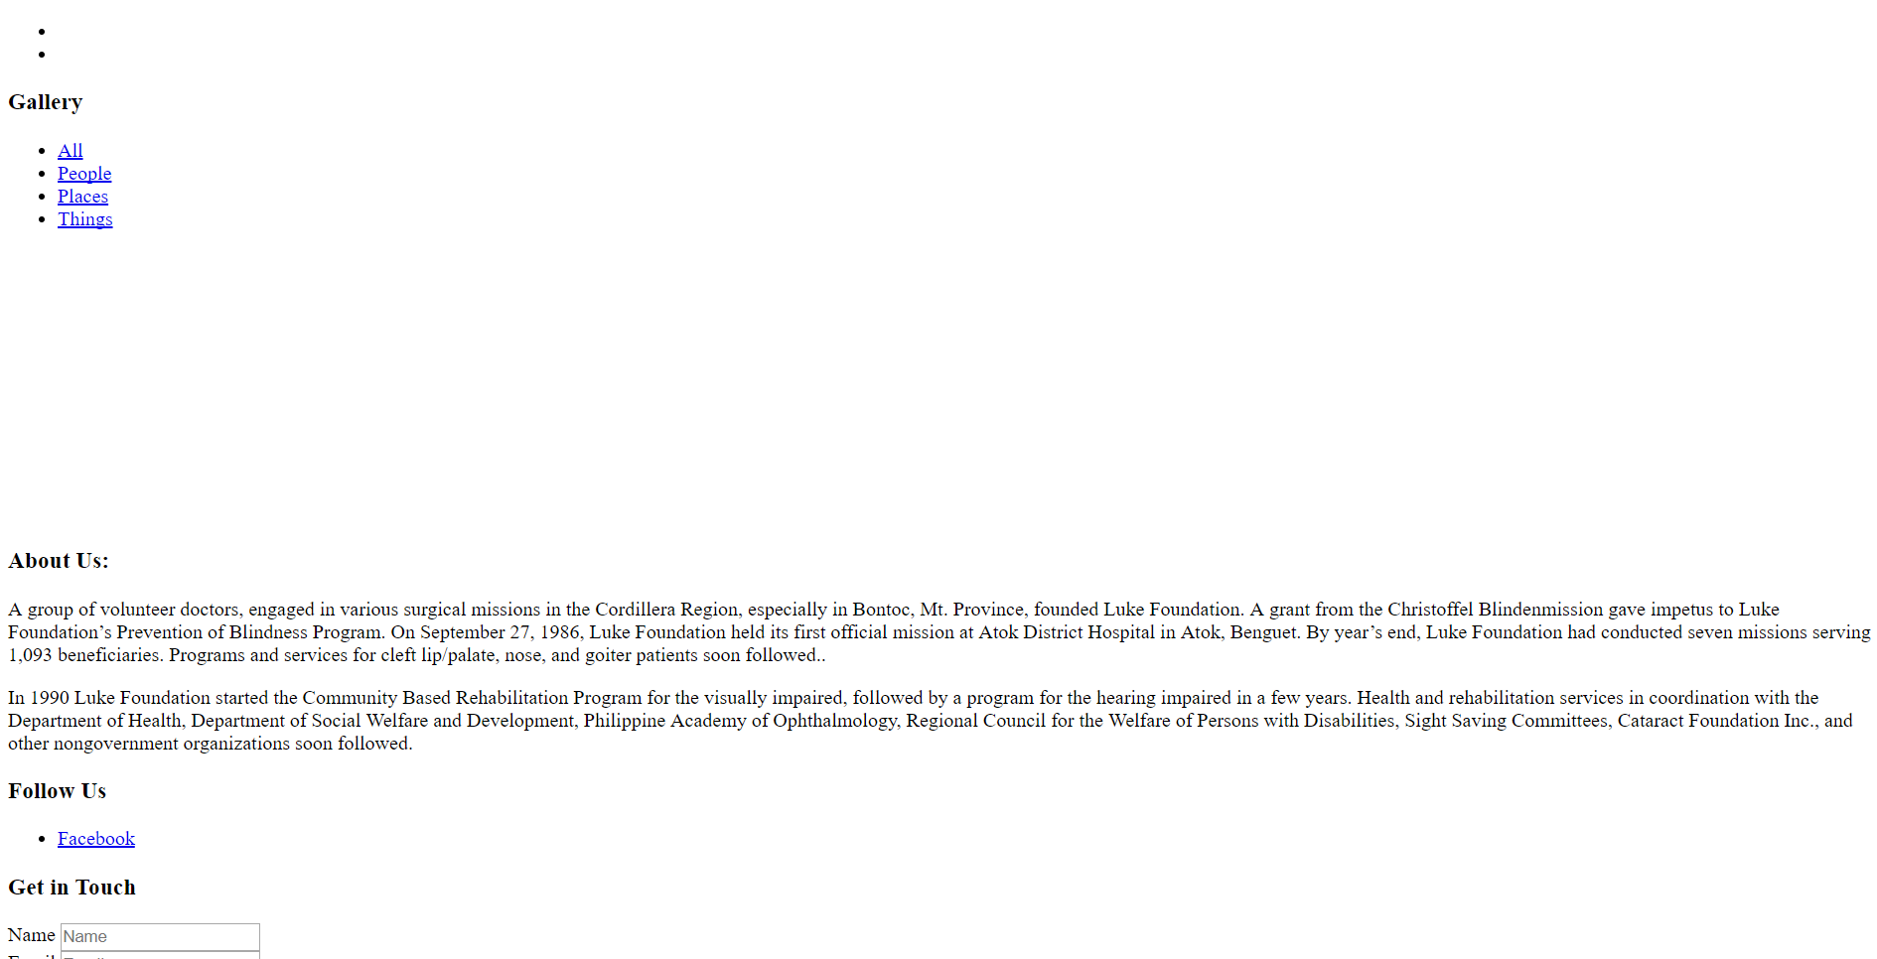
About

